Slide 1
Analysis of time series using wavelets
Aaron Coutino

Slide 2
What is a wavelet?
A wavelet is a localized wave that are near zero outside of a specific region.
Wavelets are used to decompose a given signal into frequency and time.
In general from a “mother” wavelet you have “daughter” wavelets formed by:
Where b is a translation, and a a contraction.

Slide 3
An example: the Morlet wavelet

Slide 4
How it works
Using different widths or “scales” of our mother wavelet we can project our data onto each scale and see how well the data is correlated at each scale.
By using a time shifting parameter and integrating over all times we have a transform of our function given in scale-space.
For the discrete problem x_{n} at time n separated by δt we have the “wavelet transform” is:

Slide 5
How it works
For the implementation of the transform from Boulder, the process is:
Choose a mother wavelet.
Find the Fourier transform of the mother wavelet.
Find the Fourier transform of the time series.
Choose a minimum scale.
At each scale:
Compute the daughter wavelet at the scale.
Normalize the wavelet.
Multiply by your time series.
Transform back to real space.

Slide 6
Example 1
Suppose we begin with the simple function:
By following the matlab script example1 we produce the plot:

Slide 7
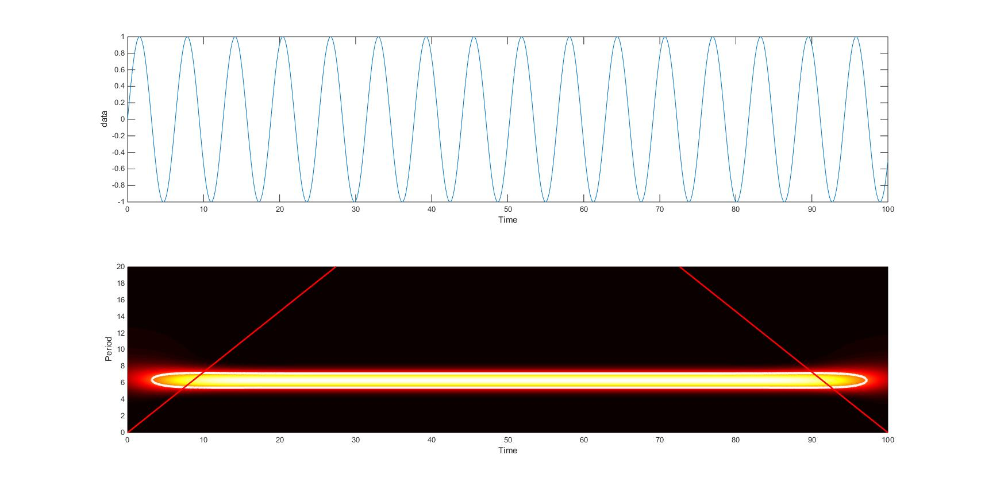
Example 1

Slide 8
Example 2
Suppose we now move to the composite function:
By following the matlab script example2 we produce the plot:

Slide 9
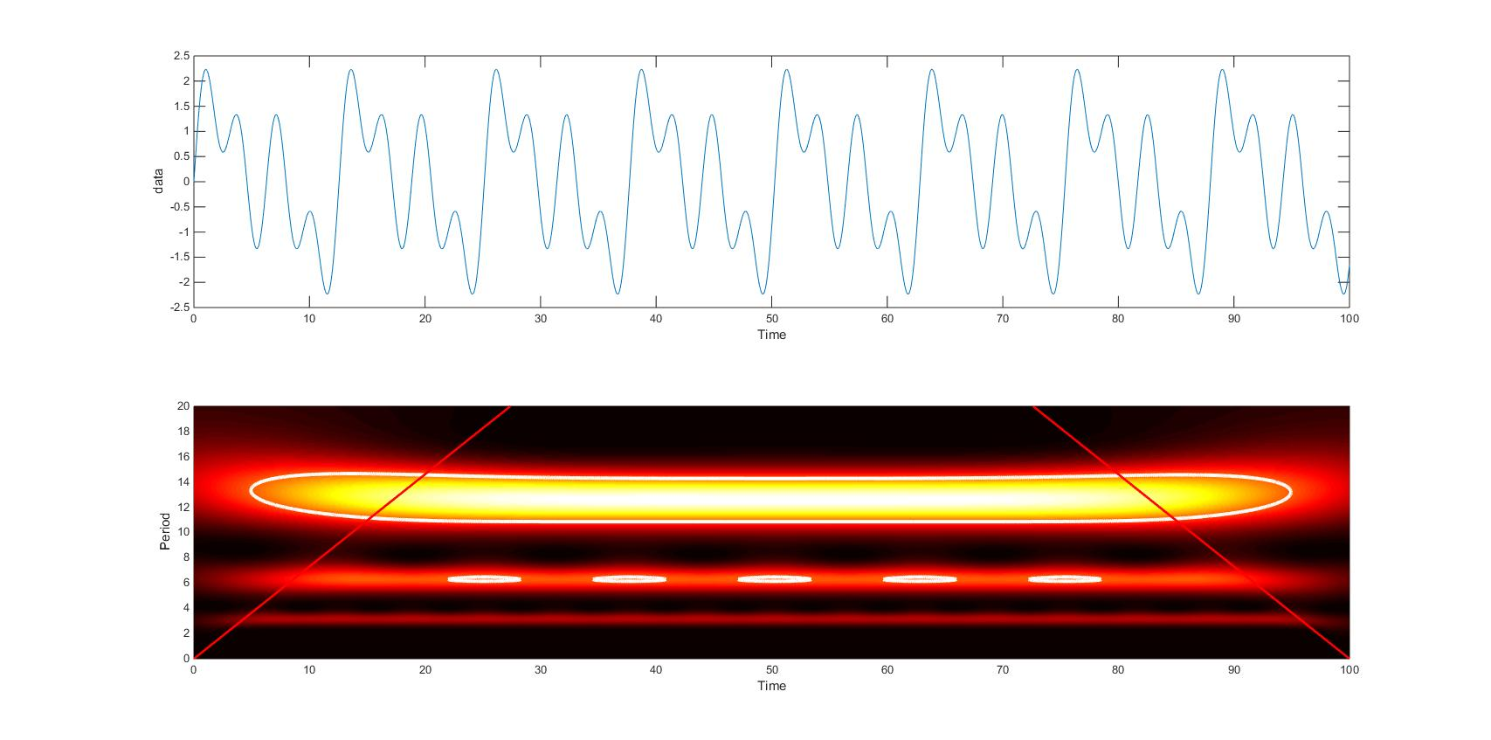
Example 2

Slide 10
Example 3
Suppose we now have the more complicated function:
By following the matlab script example3 we produce the plot:

Slide 11
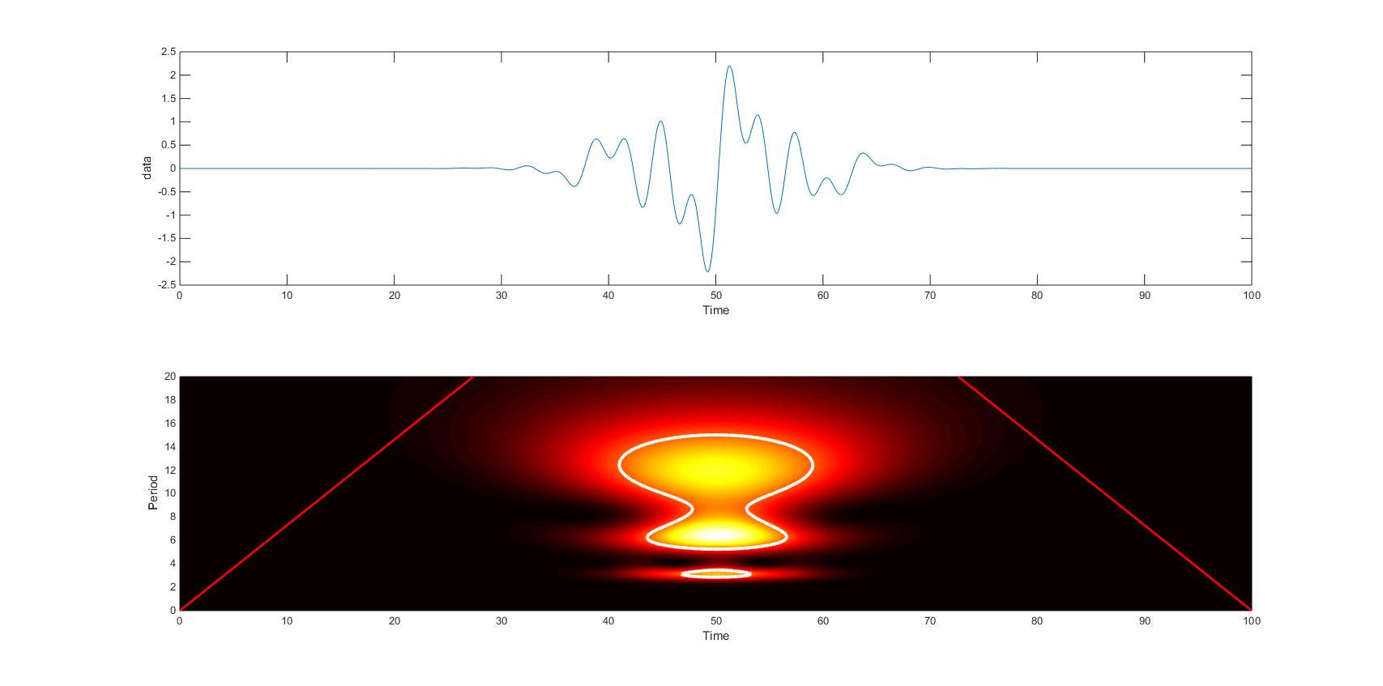
Example 3

Slide 12
Example 4
Let us now add random noise to the previous function:
By following the matlab script example3 we produce the plot:

Slide 13
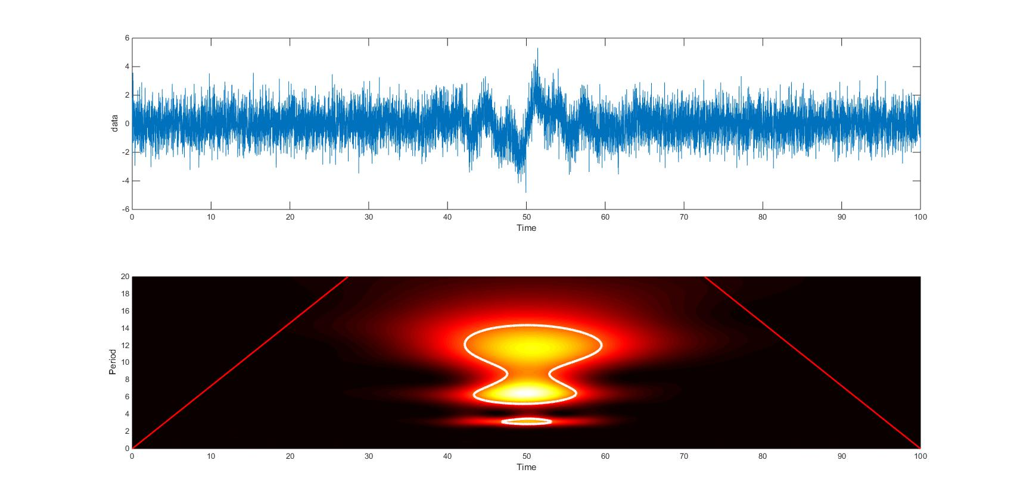
Example 4

Slide 14
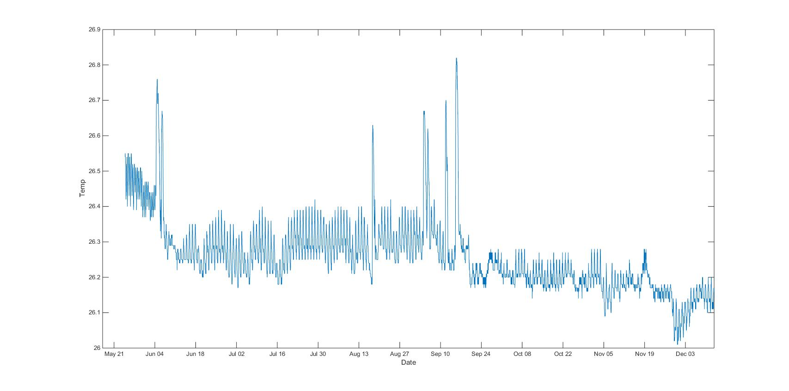
Example 5
We now finish by looking at some actual temperature data from the cenote sensors.
By following the matlab script example5 we produce the plot:

Slide 15
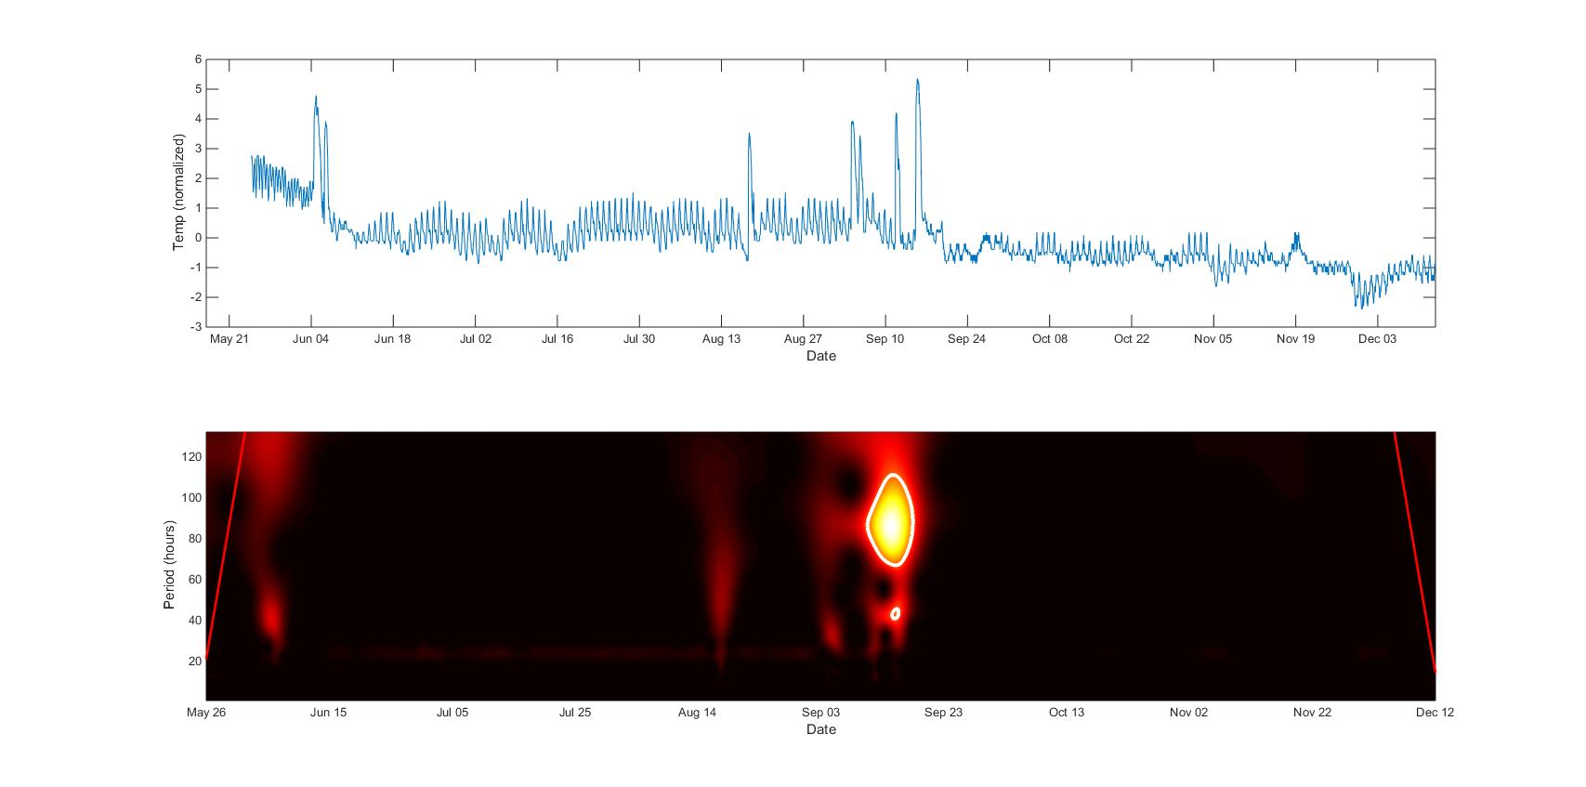
Example 5

