Slide 1
Wavelet Pooling for Convolutional Neural Networks Travis williams, Robert Li
Published At ICLR 2018
Deep Learning, fall 2018
Instructor: Prof. Ali Ghodsi
Presented by: Nargess Heydari

Slide 2
Outline
Introduction
Pooling: Pros and Cons
Wavelet Pooling
Method
Results and Discussion

Slide 3
Introduction
Network regularization studies have focused on convolutional layer operations while pooling layer operations have been left without suitable options.
Wavelet Pooling is introduced as another alternative to traditional neighborhood pooling.

Slide 4
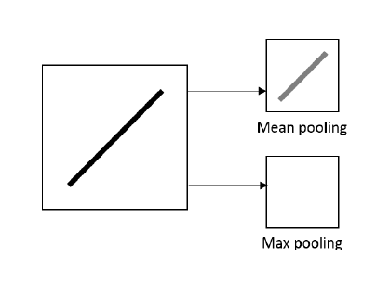
Pooling: Pros and Cons:
The benefits of pooling are to reduce parameters, increase computational efficiency, and regulate overfitting
The most famous pooling methods, Max and Average pooling are deterministic, efficient, and simple, but as neighborhood interpolation techniques, they introduce artifacts such as edge, halos, blurring, aliasing, and discontinuities.

Slide 5
Alternative Pooling Methods
Mixed pooling and stochastic pooling, use probabilistic approaches to correct some of the issues of the prior methods
Wavelet Pooling is presented as an organic, subband method that more accurately represents the feature contents with less artifacts and jagged edges.
The method decomposes features into second level decomposition and discards the first level sub-bands to reduce feature dimensions

Slide 6
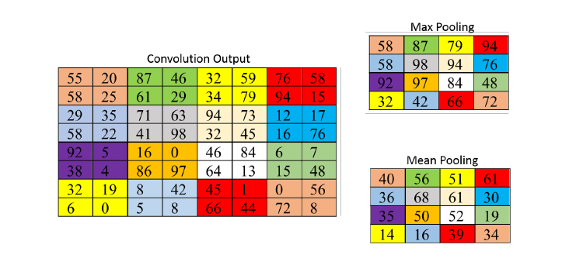
Mix Pooling
Mixed pooling
Combines max and average pooling by randomly selecting one method over the other
$a_{kij}=$ output activation of feature map k at i,j
$a_{kpq}=$ input activation at p,q
$$1<λ<0$$
For all features within a layer
Between features within a layer
For Regions within a layer

Slide 7
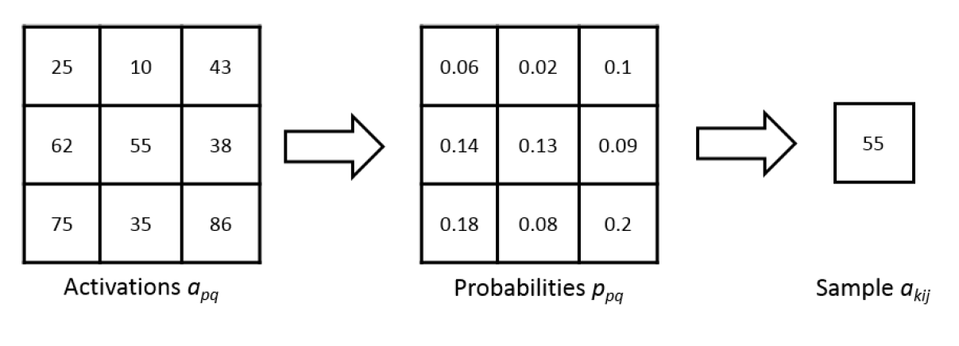
Stochastic Pooling
improves upon max pooling by randomly sampling from neighborhood regions based on the probability values of each activation
The pooled activation is sampled from a multinomial distribution

Slide 8
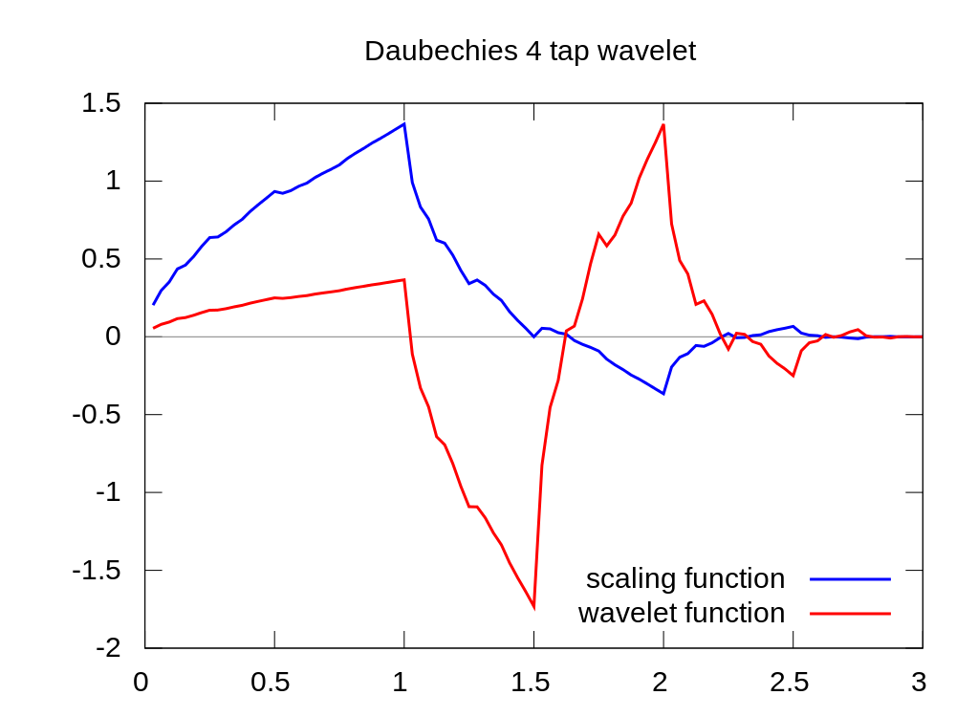
Method
Wavelets are a short ‘burst’ of waves
that quickly die away
When a signal is deconstructed into wavelets,
it is called a Wavelet Transform

Slide 9
FWT
Wavelet Vectors
Resolution Level
Approximation Coefficient
Detail Coefficient
LFP
2
LPF
2
|H|
Low-Pass Filter
High-Pass Filter
HPF
2
Signal
HPF
2
Fmax/2
fmax

Slide 10
FWT
Downsample Rows
Downsample Columns
Wavelet pooling scheme pools features by performing a 2nd order decomposition in the wavelet domain according to the fast wavelet transform (FWT)

Slide 11
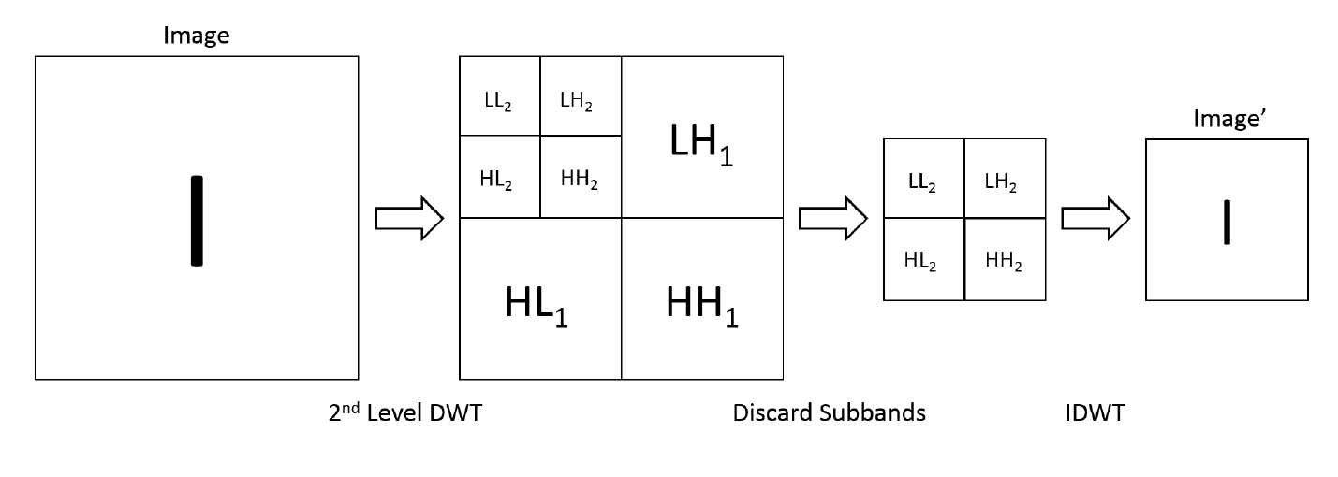
Forward Propagation
FWT is applied twice on the image (once on the rows, then again on the columns)
detail subbands (LH, HL, HH) are obtained at each decomposition level, and the approximation subband (LL) is used for the highest decomposition level.
After performing the 2nd order decomposition, the image is reconstructed but only using
the 2nd order wavelet subbands.
The image features are pooled by a factor of 2 using the inverse FWT (IFWT)

Slide 12
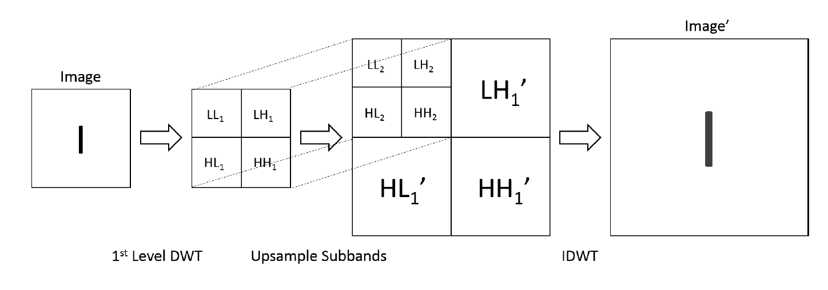
Backpropagation
1st order wavelet decomposition is applied on the image
The detail coefficient subbands upsample by a factor of 2 to create a new 1st level decomposition. The initial decomposition then becomes the 2nd level decomposition.
Finally, this new 2nd order wavelet decomposition reconstructs the image feature for further backpropagation using the IDWT

Slide 13
Results and Discussion
All CNN experiments use MatConvNet adding Batchnormalization
All training uses stochastic gradient descent
the wavelet basis is the Haar wavelet
The method is applied for all pooling layers in the network

Slide 14
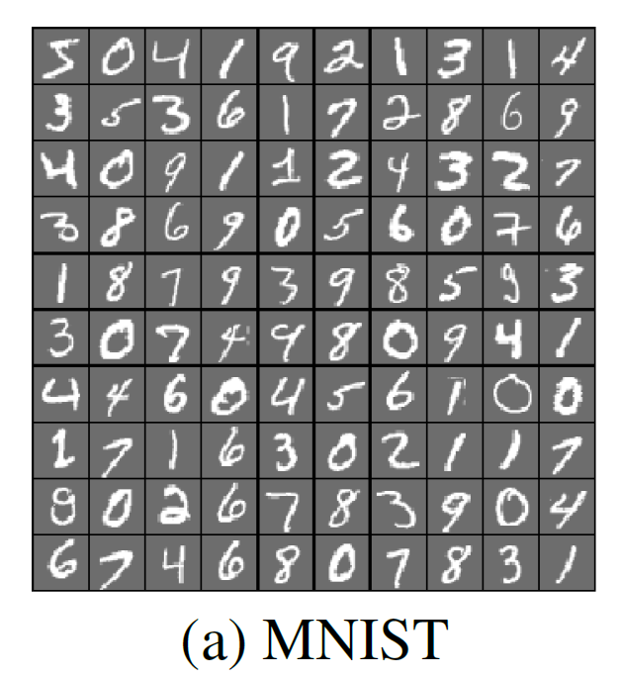
MNIST Dataset

Slide 15
MNIST Dataset Results

Slide 16
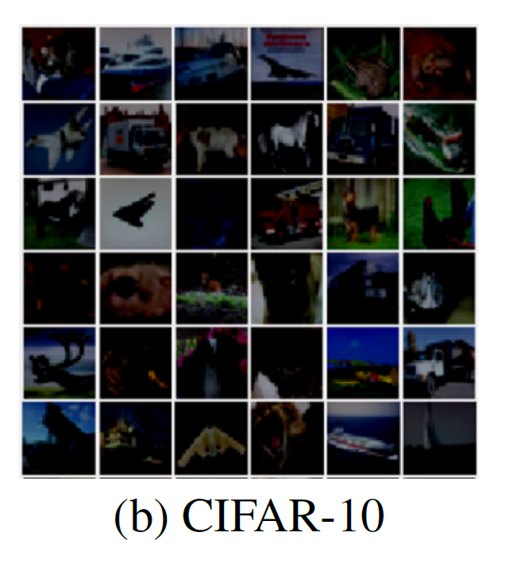
CIFAR-10 Dataset Results
They test the method for the architecture with and without dropout

Slide 17
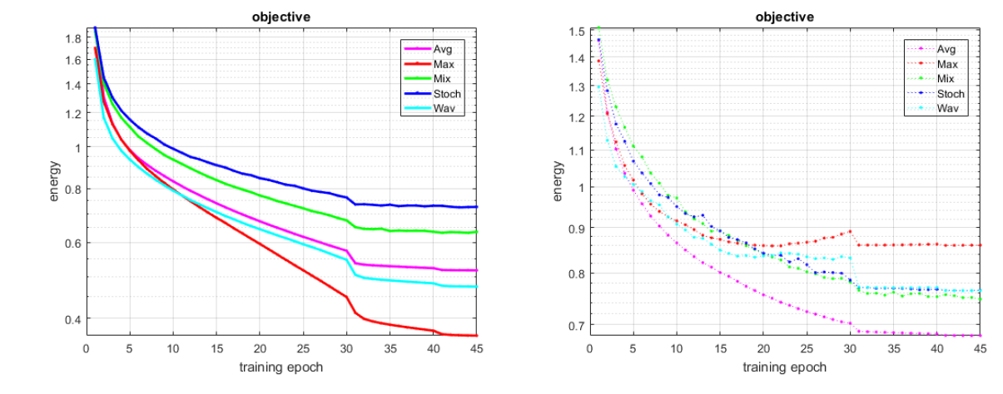
CIFAR-10 Dataset Results
+ Dropout :

Slide 18
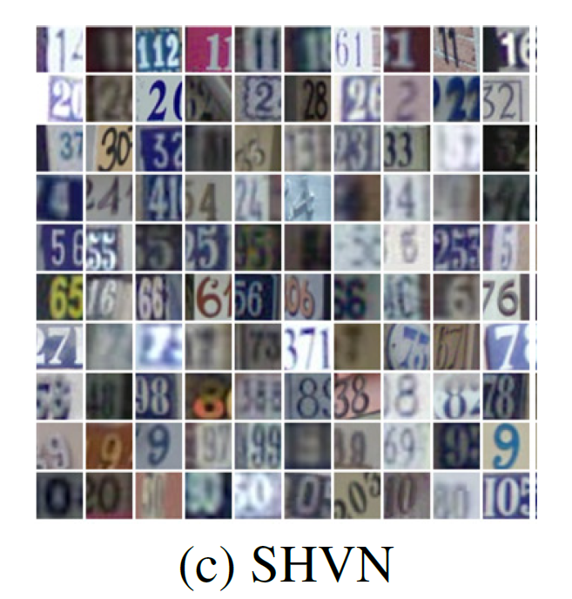
SHVN Dataset Results
They test the method for the architecture with and without dropout

Slide 19
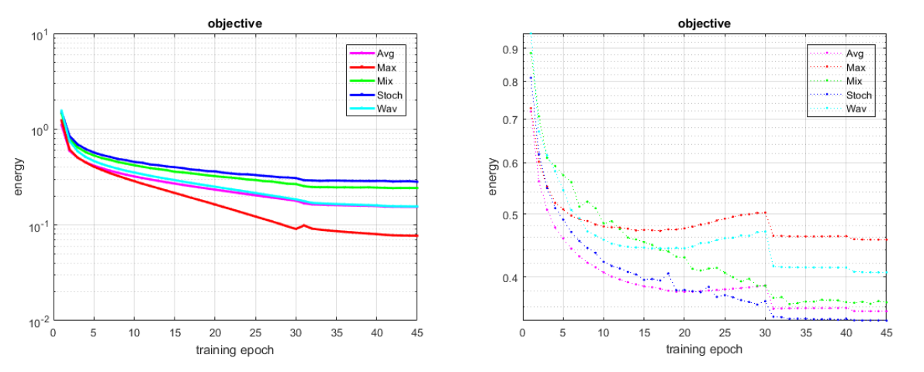
SHVN Dataset Results
+ Dropout :

Slide 20
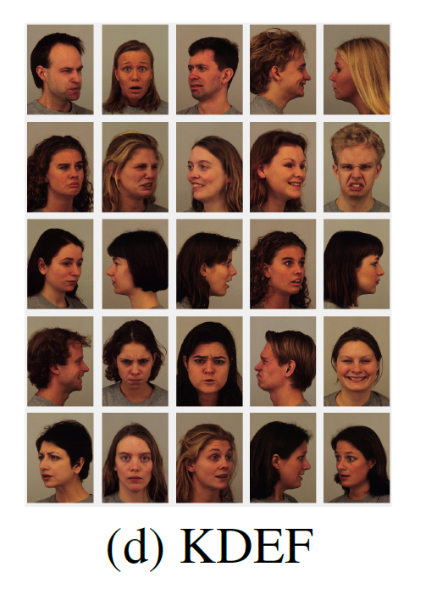
KDEF Dataset Results
They test the method for the architecture with dropout

Slide 21
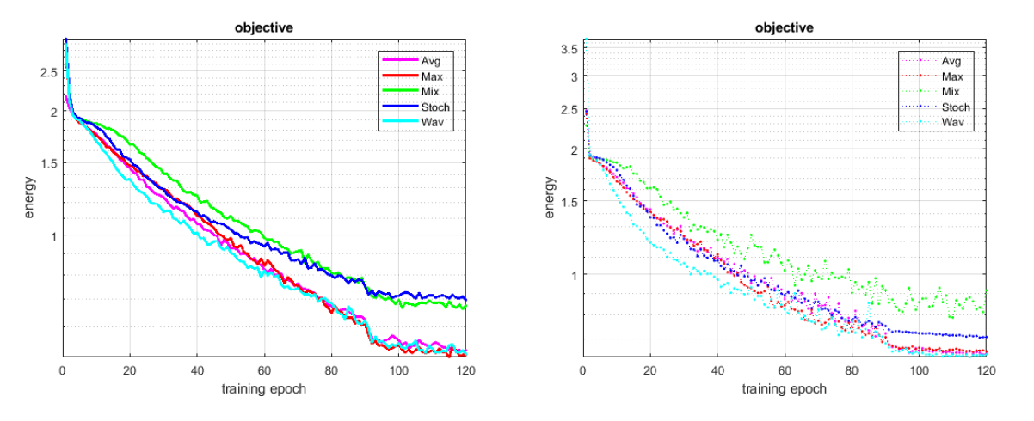
KDEF Dataset Results

Slide 22
Computational Complexity
Max: Operations in worst case scenarios in finding max
Average: Number of additions and divisions
Mixed: Mean of Max and Avg
Stochastic: by counting the number of mathematical operations as well as the random selection of the values
based on probability
Wavelet: Number of
operations for each subband at each level, in both decomposition and reconstruction
They relate it to the way they have implemented the coding

Slide 23
Critiques and Suggestions
The functionality of backpropagation process which can be a positive point of the study is not described enough comparing to the existing methods
The main study is on wavelet decomposition while the reason of using Haar as mother wavelet and the number of decomposition levels selection has not been described and are just mentioned as a future study!
Trying to extract a better relationship between dataset structure and pooling method could be so helpful.
Combination of the wavelet, Max and Average pooling can be an interesting option to investigate more on this topic

Slide 24
Thank You For Your Attention!
Questions?

